Slide 1
Unit – 4 (Part II) Type Checking
BSc CSIT 5th Semester
2020
Mid-Western University, Surkhet
Prepared By
Dabbal Singh Mahara

Slide 2
Type Checking
A type is a set of values together with a set of operations that can be performed on them
Type checking is checking that each operation in a program receives appropriate number of arguments of appropriate types in appropriate order.
The purpose of type checking is to verify that operations performed on a value are in fact permissible.
Certain operations are legal for values of each type
– It doesn’t make sense to add a function pointer and an integer in C.
– It does make sense to add two integers.
The type of an identifier is typically available from declarations, but we may have to keep track of the type of intermediate expressions.
Type errors arise when operations are performed on values that do not support that operation.

Slide 3
Type Systems
A language’s type system specifies which operations are valid for which types.
Type systems provide a concise formalization of the semantic checking rules.
A type system defines a set of types and rules to assign types to programming language constructs like informal type system rules, for example “if both operands of addition are of type integer, then the result is of type integer”.
Type Checking is the process of checking that the program obeys the type system.
A type checker implements type system.
A sound type system eliminates run-time type checking for type errors.
– Memory errors: Reading from an invalid pointer, etc.
– Violation of abstraction boundaries.

Slide 4
Type Checking Overview
Three kinds of languages:
Statically typed: All or almost all checking of types is done as part of compilation (C, ML, Java)
Dynamically typed: Almost all checking of types is done as part of program execution (Scheme, Prolog)
Untyped: No type checking (machine code)
Static typing proponents say:
– Static checking catches many programming errors at compile time
– Avoids overhead of runtime type checks
• Dynamic typing proponents say:
– Static type systems are restrictive
– Rapid prototyping easier in a dynamic type system

Slide 5
Static Checking
Refers to the compile-time checking of programs in order to ensure that the semantic conditions of the language are being followed
Examples of static checks include:
– Type checks
– Flow-of-control checks
– Uniqueness checks
– Name-related checks
Flow-of-control checks: statements that cause flow of control to leave a construct must have some place where control can be transferred; e.g., break statements in C
Uniqueness checks: a language may dictate that in some contexts, an entity can be defined exactly once; e.g., identifier declarations, labels, values in case expressions
Name-related checks: Sometimes the same name must appear two or more times; e.g., in Ada a loop or block can have a name that must then appear both at the beginning and at the end

Slide 6
Type Expression
A language usually provides a set of base types that it supports together with ways to construct other types using type constructors
Through type expressions we are able to represent types that are defined in a program
A base type is a type expression
a primitive data type such as integer, real, char, boolean, …
type-error signal an error during type checking
void : no type
A type name (e.g., a record name) is a type expression
A type constructor applied to type expressions is a type expression. E.g.,
– arrays: If T is a type expression and I is a range of integers, then array(I,T) is a type expression
– records: If T1, …, Tn are type expressions and f1, …, fn are field names, then record((f1,T1),…,(fn,Tn)) is a type expression
– pointers: If T is a type expression, then pointer(T) is a type expression Ex: pointer(int)
– functions: If T1, …, Tn, and T are type expressions, then so is (T1,…,Tn) →T. Ex: int→int represents the type of a function which takes an int value as parameter, and return type is also int.

Slide 7
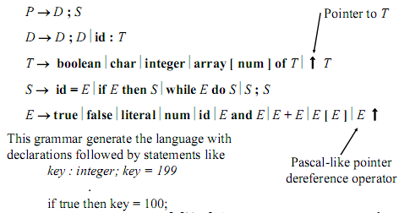
A Simple Type Checking System

Slide 8
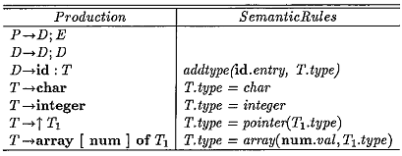
Specification of Simple Type checker
A simple type checking translation scheme for declaration is given in the following figure.
The basic types are : character and integer.
The constructed types are : array and pointer.
The type attribute is added to each symbol.
The declaration should come before the usage of the variable.

Slide 9
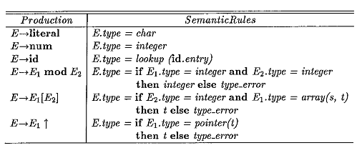
Type checking for expression
The synthesized attribute type for E gives the type of the expression assigned by the type system for the expression generated by E.
The function lookup returns the type of id.
The following figure shows the type checking for the expressions.

Slide 10
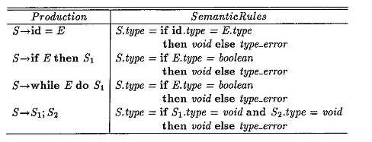
Type checking for statements
In some languages statements have a type associated with them, while some other languages don’t assign types to statements.
In the latter case, statements are given a type void to distinguish a type safe statement with one which has a type error.
if an error occurs within a statement, then the type assigned to this statement is type_error.

Slide 11
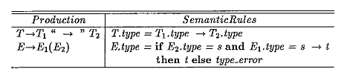
Type checking for functions
A function to an argument can be captured by production: T→T->T E→E(E) Function type declaration Function call

Slide 12
Type Conversion and Coercion
Since representation of integer and real is different within a computer, the different machine instructions are used for operations on integers and reals. Often if different parts of an expression are of different types then type conversion is required.
For example, in the expression: z = x + y what is the type of z if x is integer and y is real ?
Compilers have to convert one of the them to ensure that both operand of same type!
In many language Type conversion is explicit, for example using type casts i.e. must be specify as inttoreal(x)
Type conversions which happen implicitly is called coercion. Implicit type conversions are carried out by the compiler recognizing a type incompatibility and running a type conversion routine (for example, something like inttoreal(int)) that takes a value of the original type and returns a value of the required type.
The coercion of expressions is given in following figure.

Slide 13
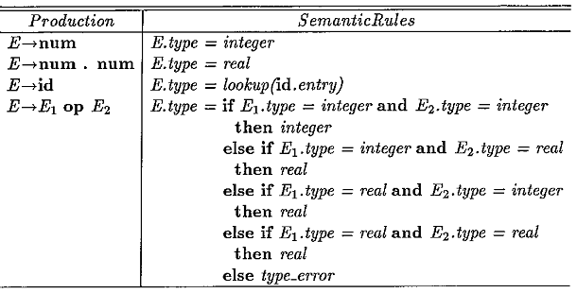
Type Conversion and Coercion (Contd.)

Slide 14
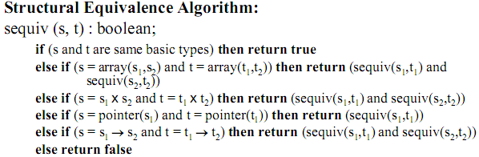
Structural Equivalence of Type Expressions
The basic question is "when are two type expressions equivalent?"
Two expressions are structurally equivalent if they are two expressions of same basic types or are formed by applying same constructor.
Example: int a, b;
Here a and b are structurally equivalent.

Slide 15
Thank You !

